Slide 1
Course : Computational Biology
Effective Period : June 2022
Molecular
Evolution

Slide 2
Learning Objectives
History of Life on Earth
Theories of Evolution
Molecular Basis of Heritable Genetic Variations
Factors that Affect Gene Frequency in a Population
Molecular Phylogenetics
Construction of the Phylogenetic Tree

Slide 3
History of Life on Earth
Observations and experiments in chemistry, geology, and physics have led scientists to propose one scenario of life on early earth from microorganisms living 3.5 billion years ago.
They hypothesize that chemical and physical processes could have produced simple cells through a sequence of four main stages:
The abiotic (nonliving) synthesis of small organic molecules, such as amino acids and nitrogenous bases
The joining of these small molecules into macromolecules, such as proteins and nucleic acids
The packaging of these molecules into protocells, droplets with membranes that maintained an internal chemistry different from that of their surroundings
The origin of self-replicating molecules that eventually made inheritance possible
Key evolutionary events : “oxygen revolution”; origin of eukaryotes, first multicellular organisms; colonization of land by large eukaryotes; origin of tetrapods; and the Permian mass extinction.

Slide 4
History of Life on Earth
Abiotic Synthesis of Macromolecules
Small organic molecules, such as amino acids and nitrogenous bases, is not sufficient for the emergence of life. Every cell has many types of macromolecules (enzymes and other proteins) and the nucleic acids needed for self-replication
A 2016 study demonstrated that the abiotic synthesis of RNA’s two purine bases, adenine (A) and guanine (G), can occur spontaneously from simple precursor molecules. the abiotic synthesis of the smaller cytosine (C) and uracil (U) bases was accomplished in 2009

Slide 5
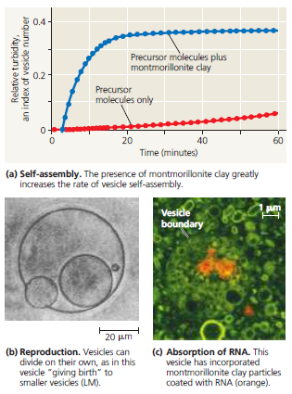
History of Life on Earth
Protocells
All organisms must be able to carry out both reproduction and energy processing (metabolism). DNA molecules carry genetic information and instructions
Abiotically produced vesicles (fluid filled compartments enclosed by a membrane-like structure) can exhibit certain properties of life, Simple reproduction and metabolism, and maintenance of an internal chemical environment different from that of their surroundings
vesicles can form spontaneously when lipids or other organic molecules are added to water. Vesicles also can absorb montmorillonite particles, including those on which RNA and other organic molecules have become attached

Slide 6
History of Life on Earth
Self-Replication RNA
The first genetic material was most likely RNA. RNA plays a central role in protein synthesis, but it can also function as an enzyme-like catalyst (ribozymes).
single-stranded RNA has a specific three-dimensional shapes based on their nucleotide sequences. The RNA molecule with the greatest ability to replicate itself will leave the most descendant molecules
On early Earth, a vesicle with such self-replicating, catalytic RNA would differ from its many neighbors that lacked such molecules. If that vesicle could grow, split, and pass its RNA molecules to its “daughters,” the daughters would be protocells.
Once RNA sequences that carried genetic information appeared in protocells, many additional changes would have been possible e.g RNA could have provided the template on which DNA nucleotides were assembled. Double stranded DNA is a more chemically stable repository for genetic information than is the more fragile RNA.

Slide 7
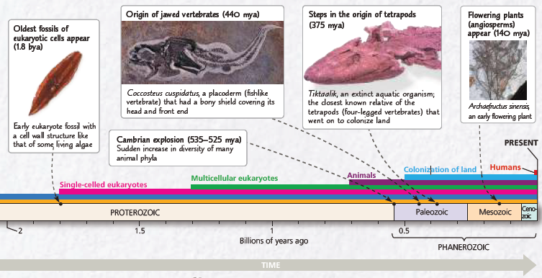
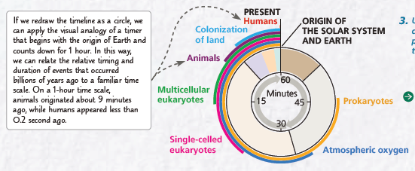
History of Life on Earth
Key events in life’s history include the origins of unicellular and multicellular organisms and the colonization of land The first three eons in the geologic record—the Hadean, the Archaean, and the Proterozoic—together lasted about 4 billion years.
The Phanerozoic eon, roughly the last half billion years, encompasses most of the time that animals have existed on Earth. It is divided into three eras:
the Paleozoic, Mesozoic, and Cenozoic.

Slide 8
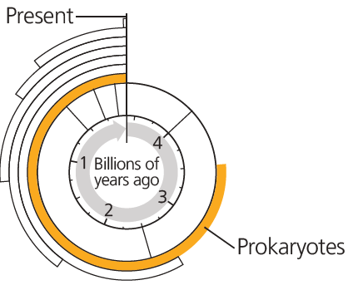
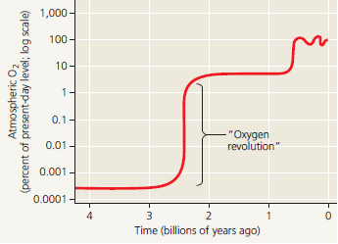
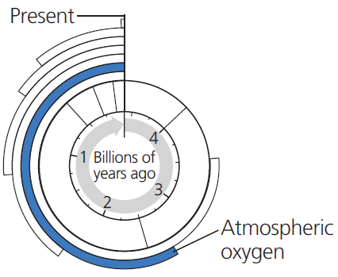
History of Life on Earth
The First Single-Celled Organisms
The earliest direct evidence of these organisms, dating from 3.5 billion years ago, comes from fossilized stromatolites (layered rocks that form when certain prokaryotes bind thin films of sediment together). Stromatolites and other early prokaryotes were Earth’s sole inhabitants for about 1.5 billion years until these prokaryotes transformed life on our planet.
Photosynthesis and the Oxygen Revolution
When oxygenic photosynthesis first
evolved—in photosynthetic prokaryotes
similar to today’s cyanobacteria— the
free O₂ it produced probably dissolved in
the surrounding water until it reached a
high enough concentration to react with elements dissolved in water. After this occurred, the O₂ finally began to “gas out” of the water and enter the atmosphere. This “oxygen revolution” had an enormous impact on life. In some of its chemical forms, oxygen attacks chemical bonds and can inhibit enzymes and damage cells.

Slide 9
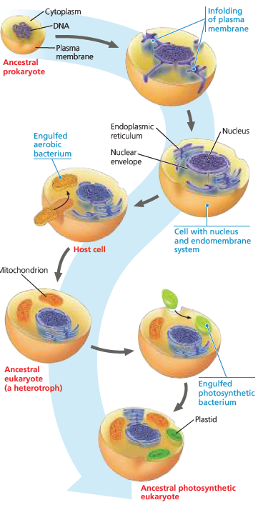
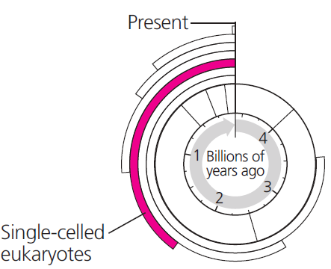
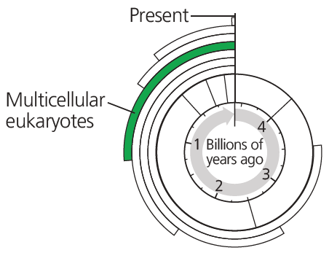
History of Life on Earth
The First Eukaryotes
Recall that eukaryotic cells have more complex organization than prokaryotic cells: Eukaryotic cells have a nuclear envelope, mitochondria, endoplasmic reticulum, and other internal structures that prokaryotes lack. (read : endosymbiosis)
By whatever means the relationship began, we can hypothesize how the symbiosis could have become beneficial. For example, in a world that was becoming increasingly aerobic, a host that was itself an anaerobe would have benefited from endosymbionts that could make use of the oxygen.
Early Multicellular Eukaryotes
The increased complexity of an orchestra makes more variations possible. After the first eukaryotes appeared, a great range of unicellular forms evolved, giving rise to the diversity of single-celled eukaryotes that continue to flourish today.
Some single celled eukaryotes gave rise to multicellular forms, whose descendants include a variety of algae, plants, fungi, and animals. Larger and more diverse multicellular eukaryotes do not appear in the fossil record until about 600 million years ago

Slide 10
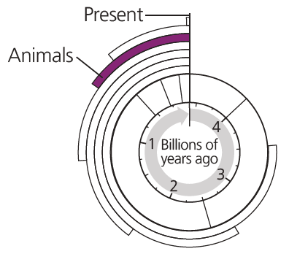
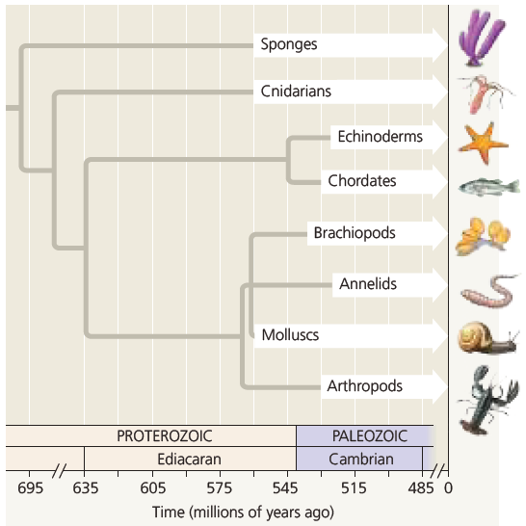
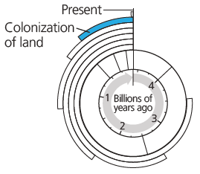
History of Life on Earth
The Cambrian Explosion
Many present-day animal phyla appear suddenly in fossils formed 535–525 million years ago, early in the Cambrian period. This phenomenon is referred to as the Cambrian explosion. Fossils of several animal groups—sponges, cnidarians (sea anemones and their relatives), and molluscs (snails, clams, and their relatives)—appear in even older rocks dating from the late Proterozoic
Overall, fossils and DNA analyses suggest that animals originated about 700 million years ago and then remained small for over 100 million years—until they diversified explosively during the Cambrian and beyond.

Slide 11
Theories of Evolution
Biological evolution is simply defined as descent with modification;
The modification may be small scale (e.g. in gene/protein sequence) or large scale (e.g. speciation). After life had originated on Earth about 3.6 billion years ago, it evolved, all from one primordial ancestral form, called the last universal common ancestor (LUCA). The evolutionary history of the descendants of LUCA constitutes the tree of life.
Evolution is a continuous process involving splitting of lineages, divergence of the descendants, and adaptive radiation into different environments (ecological niches) creating phenotypic diversity and formation of new species
Definition of species is debatable, however a species to its core is a reproductive community that represents a unique gene pool.

Slide 12
Theories of Evolution
Darwin’s theory of evolution by natural selection
states that :
variations exist among the organisms of a population
the resources (food and space) are limited,
the scarcity of resources would lead to competition among individuals, and
Individuals with favorable variations are more likely to survive in the competition whereas those that do not have the favorable variations simply die out
A basic assumption of the Darwinian theory is that new mutations, both advantageous and deleterious, constantly arise in the population independent of
need, and evolution is caused by natural selection acting through beneficial mutations by fixing them in the population.

Slide 13
Theories of Evolution : Neutral Theory
Darwinian evolution does not consider neutral mutations that do not confer any selective advantage or disadvantage to be of any importance in the evolutionary process. This long-held view of Darwinian evolution was challenged by the neutral theory of molecular evolution (Kimura M. Nature 1968;217:6246.)
The neutral theory postulates that evolutionary changes at the molecular level are not caused by natural selection alone acting only on advantageous mutations but are mostly caused by random chance fixation of selectively neutral or near-neutral alleles (genetic drift). Therefore, genetic drift plays an important role in molecular evolution.

Slide 14
Theories of Evolution : Neutral Theory
Fitness in the context of evolution means the ability to reproduce, and contribute to the gene pool of the next generation.
A nucleotide substitution that changes the corresponding amino acid in the protein is called a nonsynonymous substitution (denoted as KA), whereas a
Nucleotide substitution that does not change the amino acid in the protein is called a synonymous substitution (denoted as KS)
Typically, nonsynonymous substitutions exceed synonymous substitutions.
The average rates previously calculated were 4.7 substitutions/ synonymous site versus 0.88 substitutions/ nonsynonymous site per 10⁹ (billion) years, respectively.

Slide 15
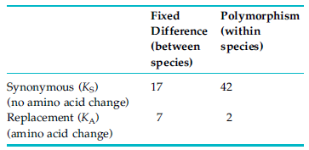
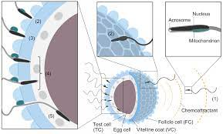
Theories of Evolution
A prediction of the neutral theory is that if the substitutions are all neutral
then for a given protein coding gene the KA/KS ratio between two species should be very similar to the same ratio within species (null hypothesis), and it is the deviation from this prediction that provides support for positive selection
McDonald and Kreitman studied the sequence evolution of the Adh gene in Drosophila melanogaster, Drosophila simulans, and Drosophila yakuba.
For example, strong signatures of positive selection, with KA/KS ratios ranging from 1.36 to 5.15, were observed when two proteins (16 and 18 kDa) in the acrosomal vesicle of abalone spermatozoa were compared. These values were among the highest for full-length sequences analyzed so far

Slide 16
Theories of Evolution
If a new mutation offers increased fitness to the carrier, it is fixed in the population through positive selection, and its frequency rapidly increases. Such rapid fixation of an advantageous mutation is called selective sweep
The increase in frequency of the neighboring genes/sequences, simply because of their close proximity to the newly fixed mutation, is called the hitchhiking effect, or genetic hitchhiking
Selective sweep and the hitchhiking effect are the results of strong positive selection. Increases of somewhat disadvantageous or deleterious mutations in the population.
McDonald and Kreitman studied the sequence evolution of the Adh gene in Drosophila melanogaster, Drosophila simulans, and Drosophila yakuba.

Slide 17
Molecular Basis of Heritable Genetic Variations
Genetic variations in a population evolve irrespective of need. Most genetic variations are deleterious or at best neutral, but some may be beneficial in a specific environment.
Four important sources of molecular genetic variations are :
Mutation
Recombination
Gene Flow
Creation of New Genes

Slide 18
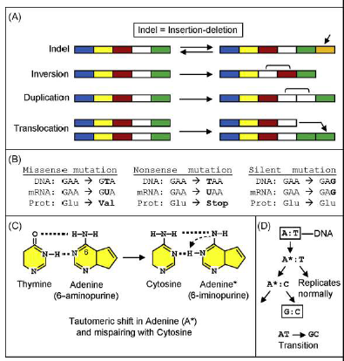
Molecular Basis of Heritable Genetic Variations
Mutation is the change of genomic sequence.
Mutation can be a point mutation (alteration of just one nucleotide), a frameshift mutation (alteration of the open reading frame (ORF) of the gene), or a chromosomal mutation—that is, large-scale alterations of the chromosomal DNA (insertion, deletion, inversion, duplication, translocation)
Based on the effect on the polypeptide product, a point mutation can be
A missense point mutation changes an amino acid in the polypeptide;
A nonsense point mutation creates a stop codon and ending polypeptide translation
A silent point mutation does not change the amino acid sequence of the polypeptide
Based on the type of base altered, a point mutation can be classified as
Transition
Transversion

Slide 19
Molecular Basis of Heritable Genetic Variations
In genetic recombination, a DNA segment moves from one DNA molecule to another DNA molecule. Recombination can take place between two homologous sequences or two nonhomologous sequences.
Recombination between two homologous sequences is called homologous recombination and it occurs during meiosis between two homologous DNA molecules (homologous chromosomes) by crossing over. The frequency of homologous recombination is low
Recombination between two nonhomologous sequences can be mediated by site specific recombination. Site-specific recombination occurs when two nonhomologous DNA molecules have only a small region of sequence identity; recombination occurs using this small region
non-allelic homologous recombination (NAHR).
NAHR is driven by sequence identity, and it results in deletion in one chromosome and duplication in the other chromosome may result in gene conversion. NAHR may lead to loss or increased copy number of specific genes, resulting in copy number variations (CNVs). Such CNVs have major implications in health and disease as well as genome evolution.

Slide 20
Molecular Basis of Heritable Genetic Variations
Gene flow is also called gene migration. Gene flow is the transfer of genetic material from one population to another. Gene flow can take place between two populations of the same species through migration and is mediated by reproduction. This resulted in vertical gene transfer from parent to offspring. Alternatively, gene flow can take place between two different species through horizontal gene transfer
Gene flow within a population can increase the genetic variation of the population, whereas gene flow between genetically distant populations can reduce the genetic difference between the populations.

Slide 21
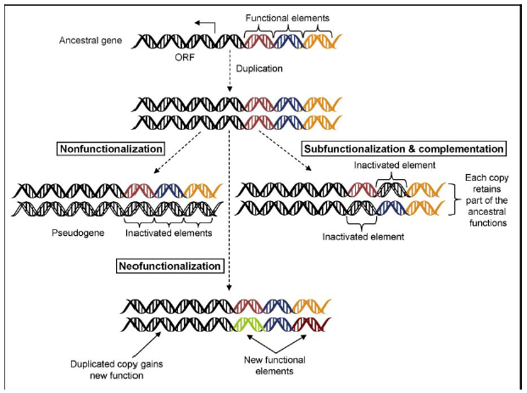
Molecular Basis of Heritable Genetic Variations
Generation of new genes is an important mechanism for creating genetic novelties; It is an important driving force of evolution in to create New genes by two major processes
Processes that use coding sequences (pre-existing genes) as the raw materials
Processes that use noncoding sequences as the raw material.
Using coding sequences (pre-existing genes) as the raw materials
Gene Duplication (on the right image)
Exon Shuffling
Gene Fusion and Fission
Horizontal Gene Transfer
Three possible fates of duplicated genes: pseudogenization (nonfunctionalization), neofunctionalization, and subfunctionalization

Slide 22
Molecular Basis of Heritable Genetic Variations
Generation of new genes is an important mechanism for creating genetic novelties; It is an important driving force of evolution in to create New genes by two major processes
Processes that use coding sequences (pre-existing genes) as the raw materials
Processes that use noncoding sequences as the raw material.
Using coding sequences (pre-existing genes) as the raw materials
Gene Duplication (on the right image)
Exon Shuffling
Gene Fusion and Fission
Horizontal Gene Transfer
Three possible fates of duplicated genes: pseudogenization (nonfunctionalization), neofunctionalization, and subfunctionalization

Slide 23
Molecular Basis of Heritable Genetic Variations
Generation of new genes is an important mechanism for creating genetic novelties; It is an important driving force of evolution in to create New genes by two major processes
Processes that use coding sequences (pre-existing genes) as the raw materials
Processes that use noncoding sequences as the raw material.
Origin (de Novo) of New Genes from Noncoding Sequences
The processes of how a new gene is created de novo from noncoding sequence are not well understood. For a noncoding DNA to give birth to a protein-coding gene, two features are needed:
the DNA must be transcription- competent, and
the DNA must acquire an open reading frame.
It is being increasingly appreciated that a rare but consistent feature of eukaryotic genomes is the evolution of new genes de novo. One characteristic of genes originated de novo is that these genes are usually simple (mostly single exon) so that their evolution de novo would be possible.

Slide 24
Molecular Basis of Heritable Genetic Variations

Slide 25
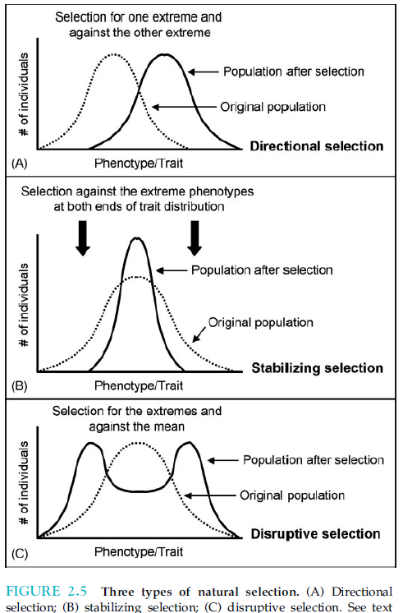
Factors that Affect Gene Frequency in a Population
Changes in allele frequency initially result in microevolution, which introduces genetic variations in a population through processes such as mutation, migration, selection, genetic drift, population bottlenecks, and even relaxation of purifying selection
Mutation
Migration (Gene Flow)
Natural Selection
Genetic Drift
Non-Random Mating
"Allele" is the word that we use to describe the alternative form or versions of a gene.

Slide 26
Phylogeny and Phylogenetic Tree
Phylogenetics is the study of phylogenies—that is, the study of the evolutionary relationships among various organisms and populations. According to evolutionary theory, the similarity among organisms and groups of organisms is attributable to their descent from a common ancestor.
The use of DNA and protein sequence information and their change over evolutionary time in order to infer the evolutionary relationship among a set of homologous genes or proteins is referred to as molecular phylogenetics.
The goal of molecular phylogenetics is to estimate the evolutionary divergence of the DNA and protein sequences from a common ancestral sequence, and thus reconstruct the correct evolutionary relationships among these sequences in the form of a phylogenetic tree.

Slide 27
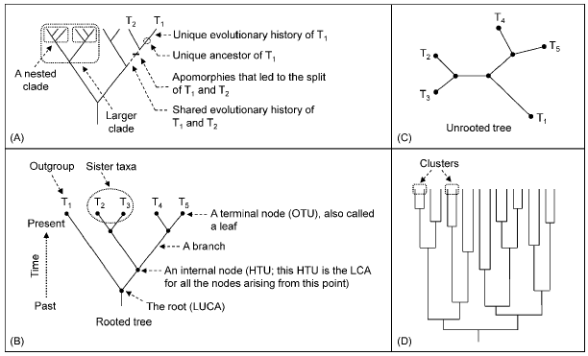
Phylogenetic Tree
A phylogenetic tree (or evolutionary tree, cladogram, or dendrogram) is a diagrammatic representation of the evolutionary relationship among various taxa. The phylogenetic tree has its own reconstruction and reliability assessment.
It is a branching diagram composed of nodes and branches. The branching pattern of a tree is called the topology of the tree. One branch can connect only two nodes.
The terminal nodes represent the operational taxonomic units (OTUs) or leaves. The OTUs are the actual objects—such as the species, populations, or gene or protein sequences—being compared, whereas the internal nodes represent hypothetical taxonomic units (HTUs).

Slide 28
Phylogenetic Tree
Assumptions behind making a phylogenetic tree, such as :
the sequences are homologous— that is, the sequences share a common ancestry, and they diverged through time as they evolved—and
Each position evolved independently. The quality of multiple sequence alignment is the key to obtaining a reliable phylogenetic tree.
When using coding sequences, it is desirable to use the protein sequences to reconstruct the phylogenetic tree.
Construction of a phylogenetic tree involves the following steps:
Selection of the appropriate molecular marker (genes/ proteins/ mitochondrial DNA)
Multiple sequence alignment
Selection of a model of evolution
Construction of the phylogenetic tree
Assessment of the reliability of the tree.

Slide 29
Selection of the Appropriate Molecular Marker
A molecular marker in phylogenetic analysis is the biological information that is used to infer the evolutionary relationships among taxa. Some of the reasons why protein sequences are more appropriate compared to nucleic acid are as follows:
There are more possible character states for amino acids (20) than nucleotides (4); the terminals may share a character state by chance simply because a given position can have only one of 4 possible character states (as opposed to 20 for amino acids).
Amino-acid-substitution matrices are more sophisticated than nucleotide-substitution matrices.
The existence of codon bias for the same amino acid in different species might artificially inflate the nucleotide sequence variation.
Slowly evolving gene sequences can be used to assess the evolutionary relationship between distantly related species and, conversely, rapidly evolving gene sequences can be used for recently evolved species.
When using coding sequences, it is desirable to use the protein sequences to reconstruct the phylogenetic tree.

Slide 30
Multiple Sequence Alignment
Alignment of sequences is the most important step in constructing a reliable phylogenetic tree. Multiple sequence alignment identifies blocks of conserved residues. A good alignment should also have fewer gaps/ long gaps.
Gaps indicate sequences gained or lost (insertions/ deletions) during evolution
There are no set rules regarding which sections of the alignment to remove; the user should apply judgment. If the alignment is ambiguous at the two ends, the ends can be removed.

Slide 31
Selection of a Model of Evolution
An evolutionary model of sequence data is a model of nucleotide or amino-acid substitution and consequent divergence of sequences. These models filter the complexity of the biological mutation process into simpler patterns that can be described and predicted using a small number of statistical parameters
The simplest substitution model for nucleotides is the Jukes-Cantor (JC) one-parameter model. Other models are :
Kimura’s two-parameter model
Felsenstein model
Hasegawa-Kishono-Yano (HKY) model
The simplest model for amino acid substitution models is BishopFriday model.
Other models are :
Dayhoff model (PAM)
JonesTaylorThornton (JTT) model
Whelan and Goldman (WAG) model
Le Gascuel (LG) model

Slide 32
Construction of the Phylogenetic Tree
This is a highly specialized area of computation and statistics. Therefore, only some overall principles are discussed here. The methods to construct phylogenetic trees can be classified into two major types:
Distance-based
  Unweighted Pair Group Method with Arithmetic mean (UPGMA)
  Neighbor Joining (NJ).
Character-based, also called the discrete method
  Maximum Parsimony (MP)
  Maximum Likelihood (ML).

Slide 33
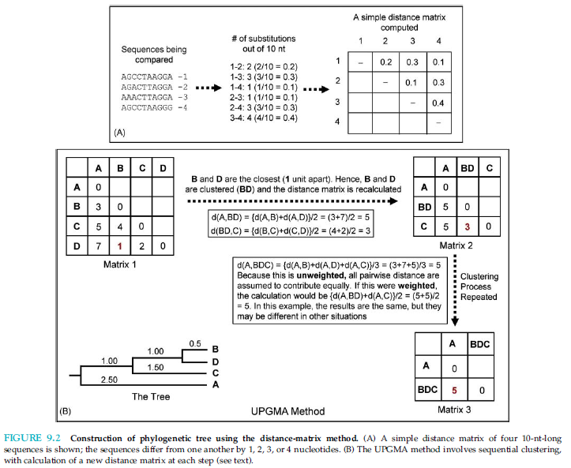
Construction of the Phylogenetic Tree
A simple distance matrix
The UPGMA method involves sequential clustering

Slide 34
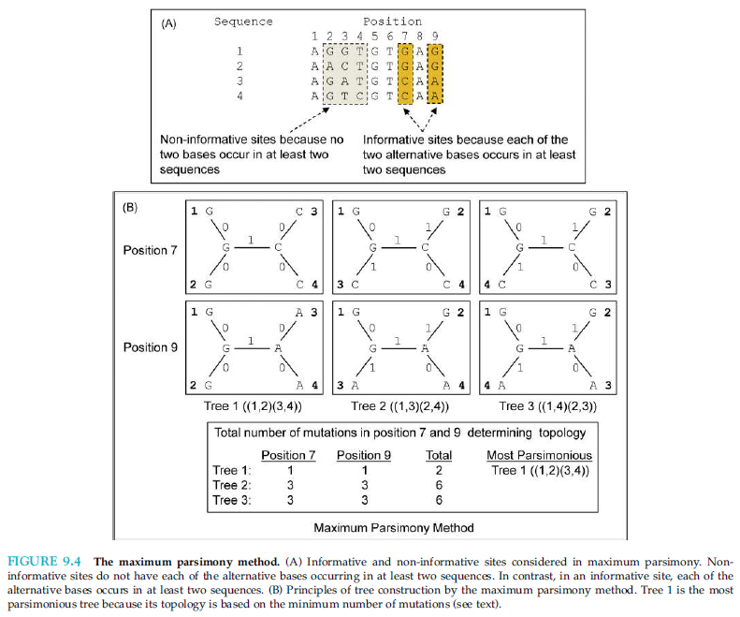
Construction of the Phylogenetic Tree
Maximum Parsimony (MP)

Slide 35
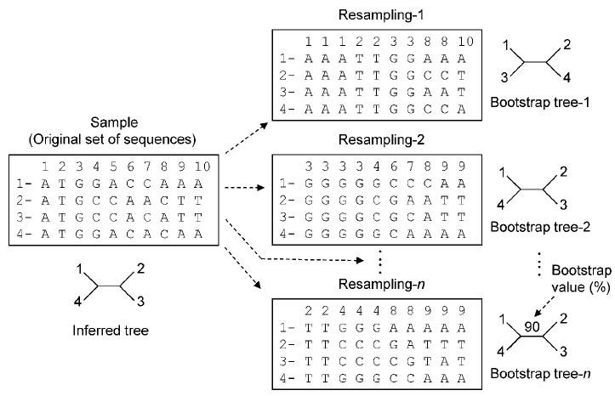
Assessment of the Reliability of The Tree.
Construction of a phylogenetic tree is followed by an assessment of the reliability of the tree. Determining the reliability of the tree means determining whether the topology of the tree is accurate or whether a better tree can be obtained. These questions are answered by bootstrapping the reconstructed tree.
The bootstrap method involves repeated resampling (with replacement) from the original sample to create many new subsets of pseudosamples that are subjected to the same analysis as the original sample to obtain many bootstrap trees.
The topology of these bootstrap trees is compared with that of the original tree to statistically assess the reliability of the original phylogenetic tree

Slide 36
References
Lisa A. Urry, Micheal L. Cain, Steven A. Wasserman, Peter V. Min. Campbell Biology 12th Edition,, Pearson (Chapter 4)
Choudhuri, S.. (2014) Bioinformatics for Beginners: Genes, Genomes, Molecular Evolution, Databases and Analytical Tools. Elsevier. ISBN 978-0124104716 (Chapter 8)

